Slide 1
Chapter 08 Abstract Classes
FALL 2021

Slide 2
Abstract Classes and Methods
Abstract Classes
Classes that are too general to create real objects
Example: food, number
Used only as abstract superclasses for concrete subclasses and to declare reference variables
Many inheritance hierarchies have abstract superclasses occupying the top few levels
Keyword abstract
Used to declare a class abstract
Used to declare a method abstract
Abstract classes normally contain one or more abstract methods
All concrete subclasses must override all inherited abstract methods.

Slide 3
Abstract Classes
An abstract class declares common attributes and behaviors of the various classes in a class hierarchy.
An abstract class typically contains one or more abstract methods that subclasses must override if the subclasses are to be concrete.
The instance variable and concrete methods of an abstract class are subject to the normal rules of inheritance.

Slide 4
Common Programming Error
Attempting to instantiate an object of an abstract class is a compilation error.
Failure to implement a superclasse’s abstract method in a subclass is a compilation error unless the subclass is also declared abstract.

Slide 5
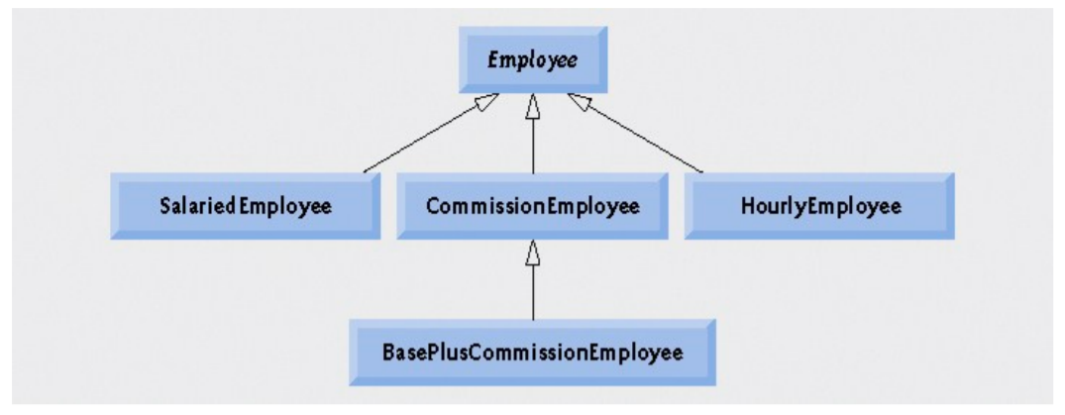

Slide 6
Example
Abstract superclass Employee
Earnings() is declared abstract
No implementation can be given for earnings() in the Employee abstract class
An array of Employee variables will store references to subclass objects
Earnings() method calls from these variables will call the appropriate version of the earnings() method.

Slide 7
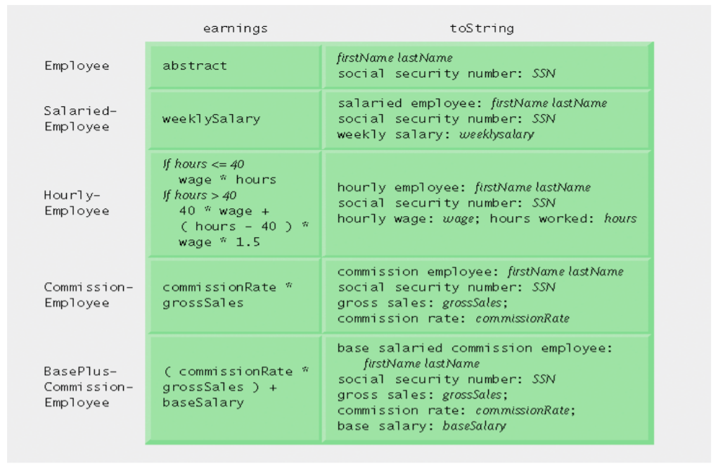

Slide 8
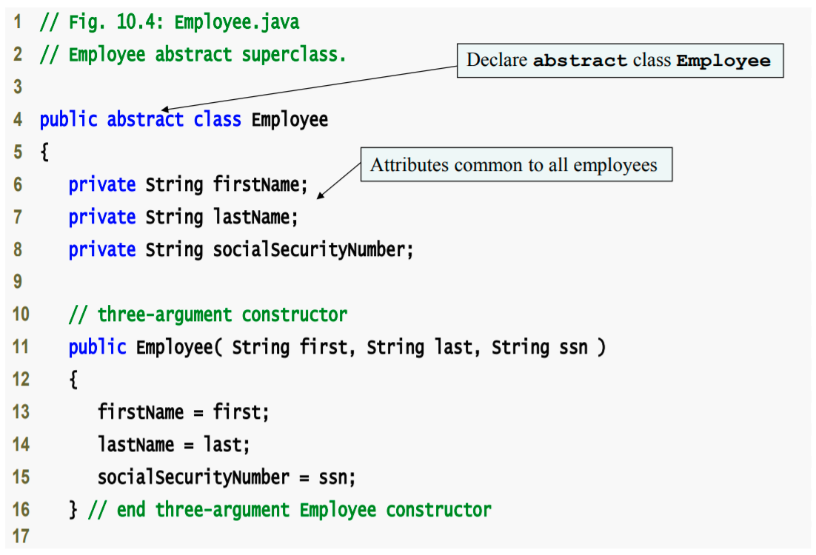

Slide 9
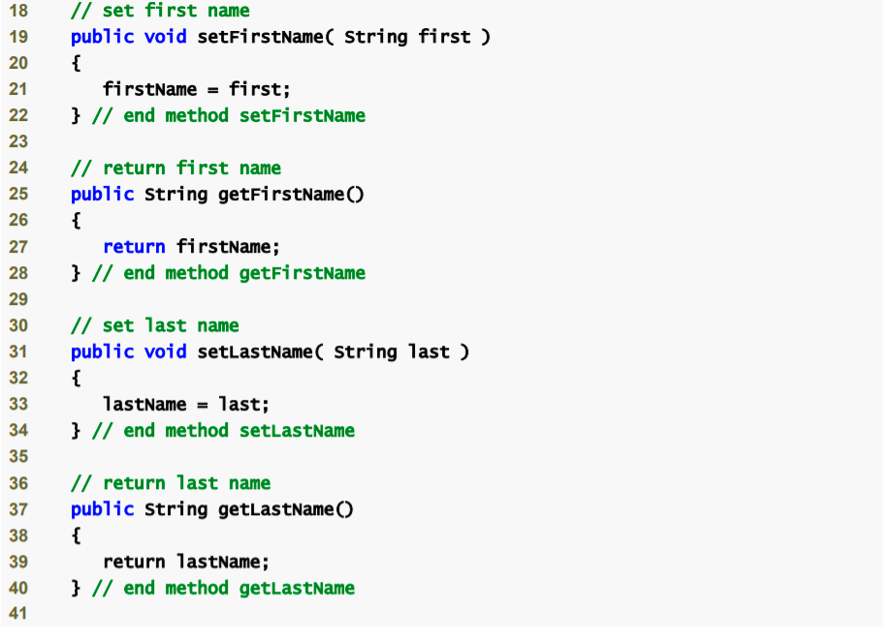

Slide 10
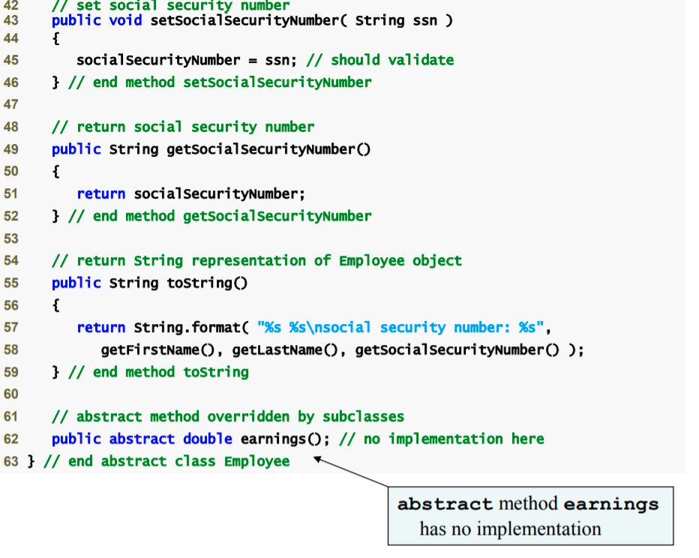

Slide 11
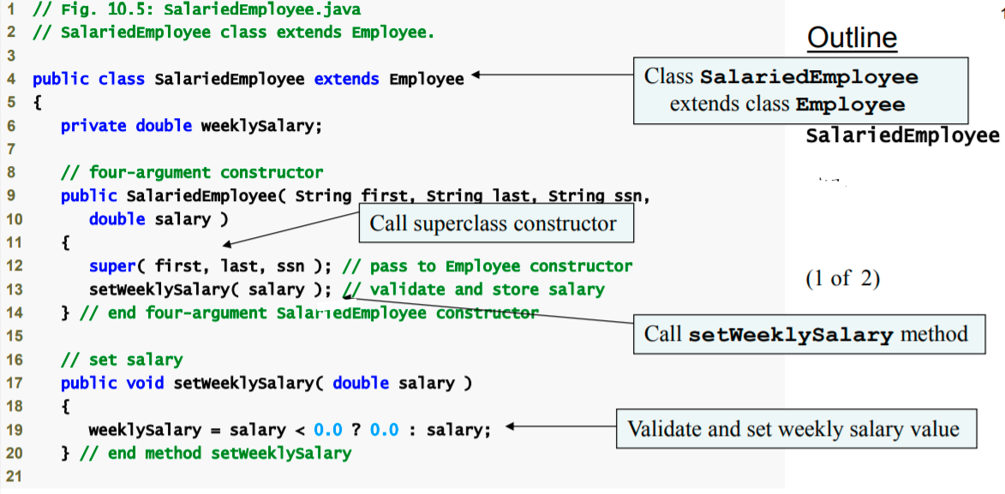

Slide 12
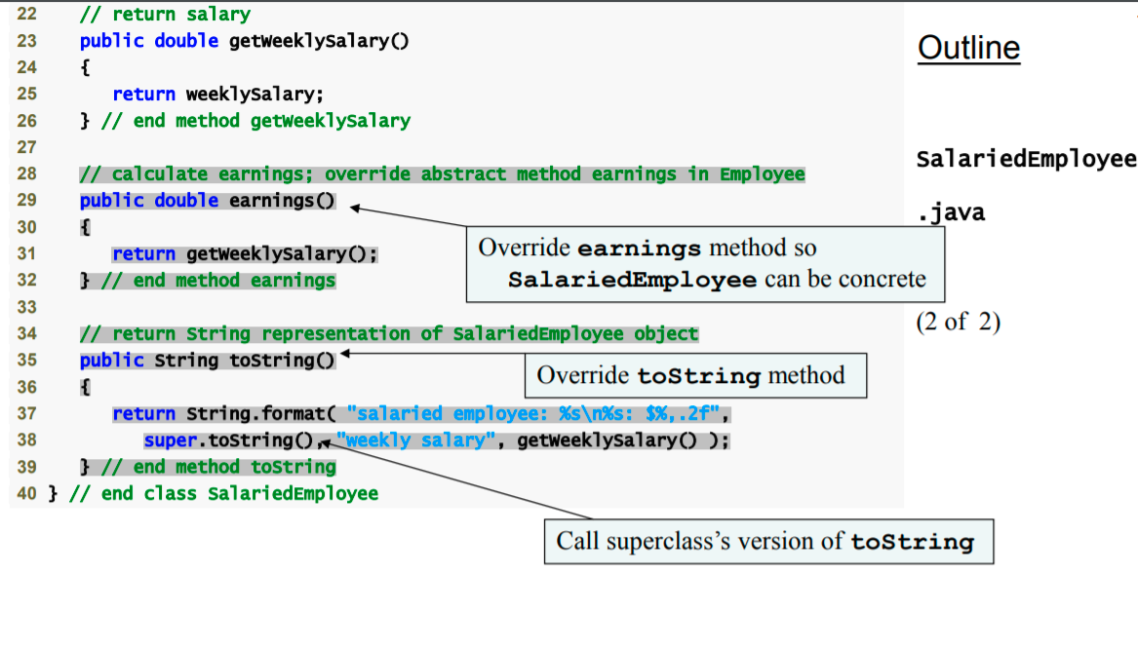

Slide 13
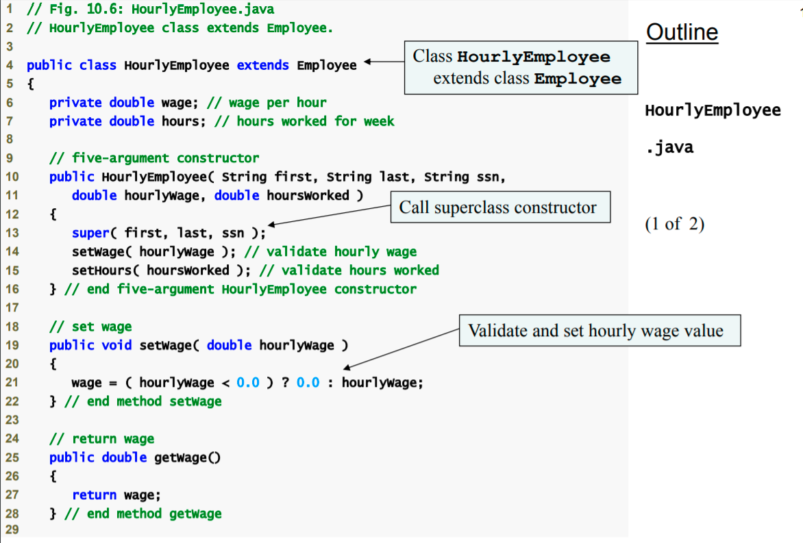

Slide 14
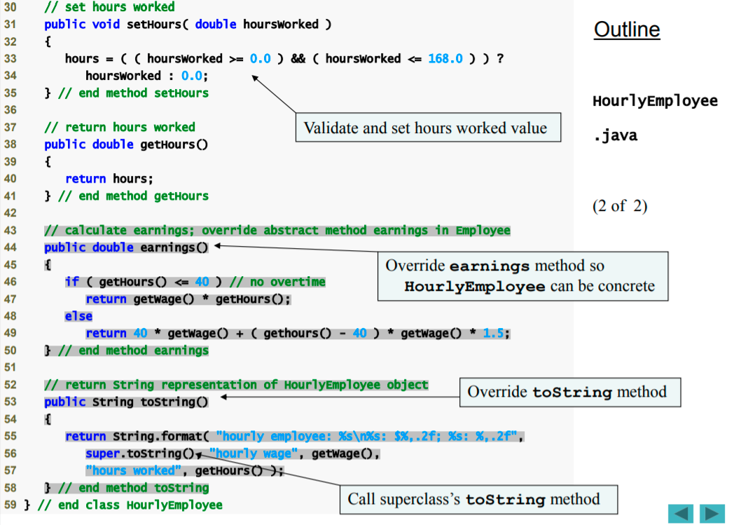

Slide 15
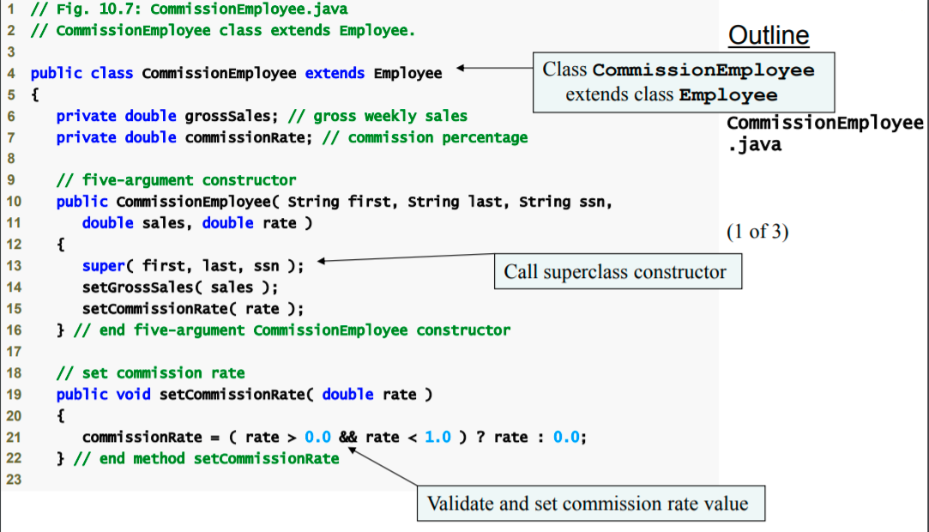

Slide 16
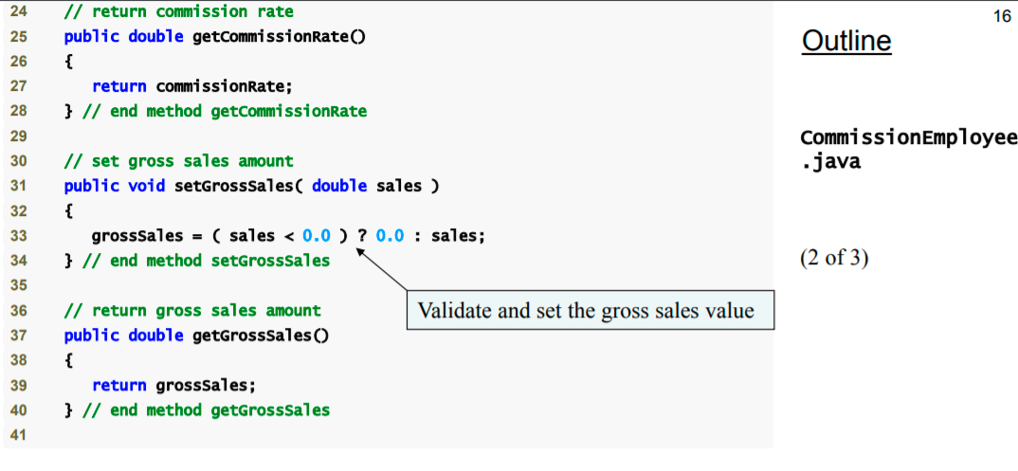

Slide 17
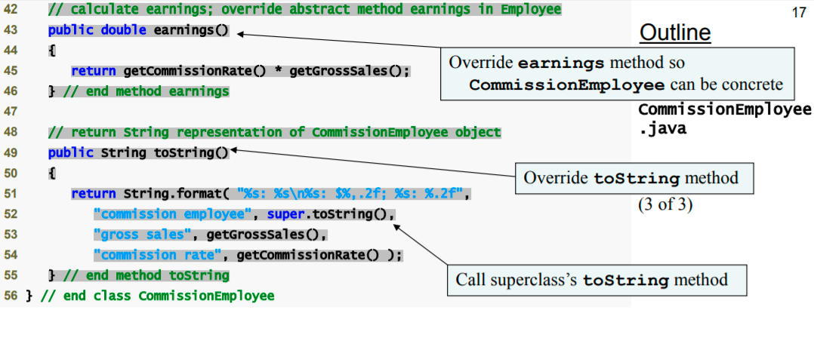

Slide 18
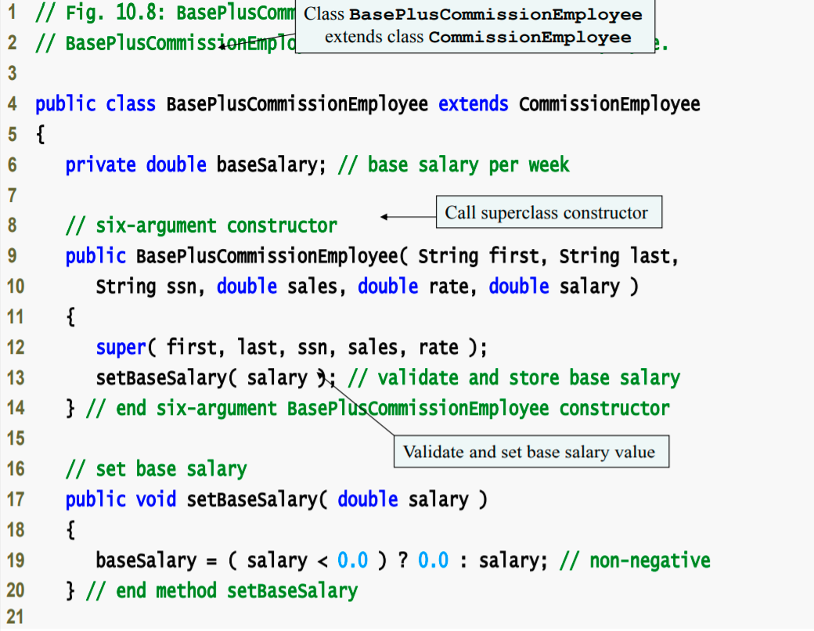

Slide 19
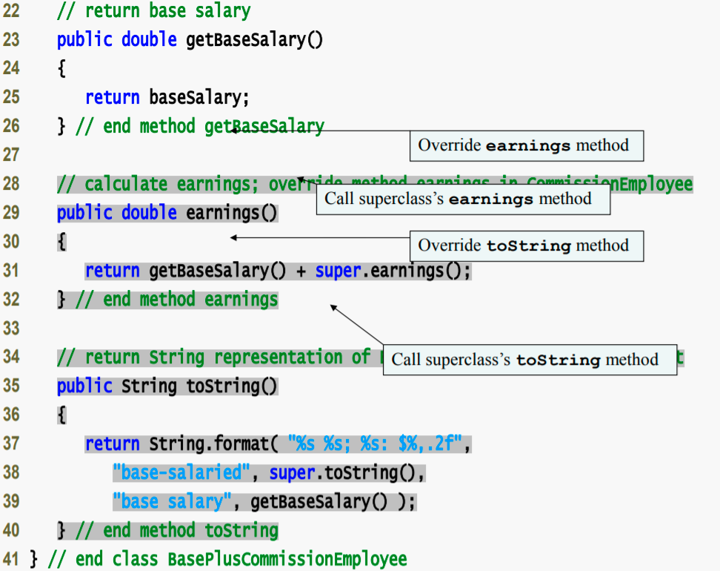

Slide 20
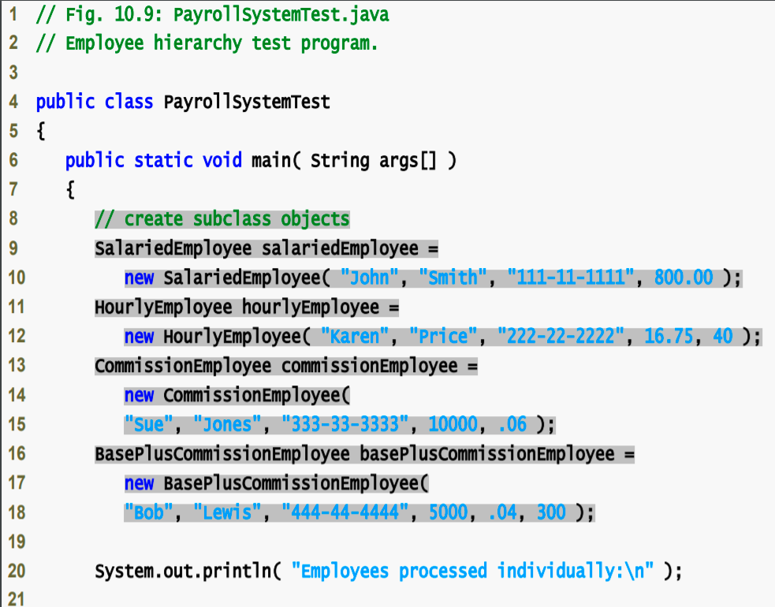

Slide 21
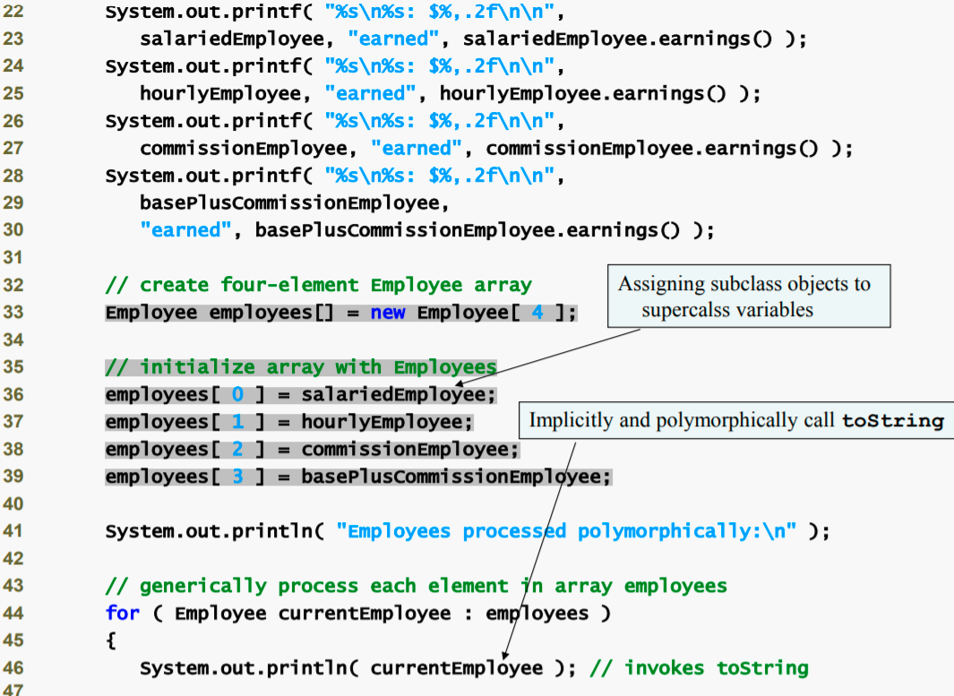

Slide 22
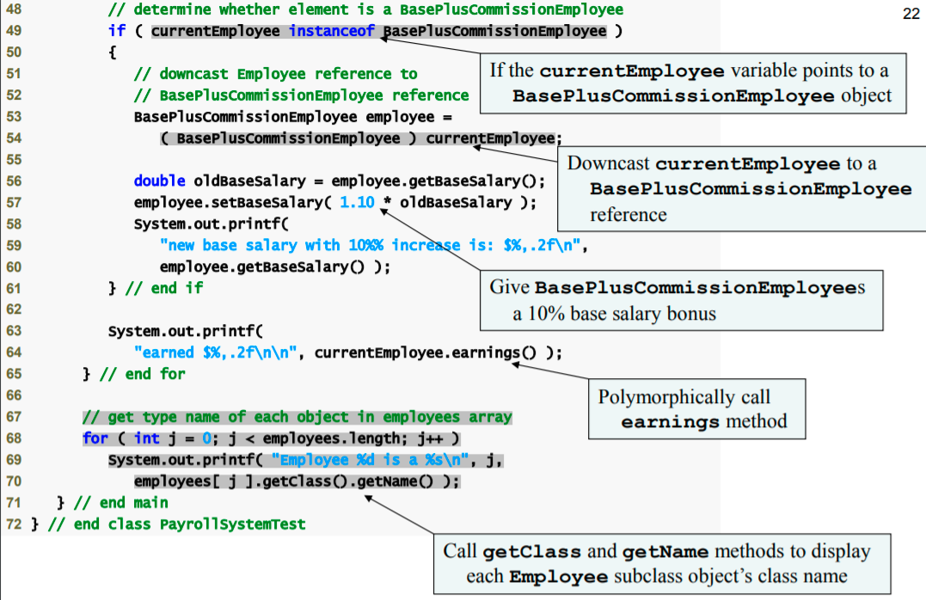

Slide 23
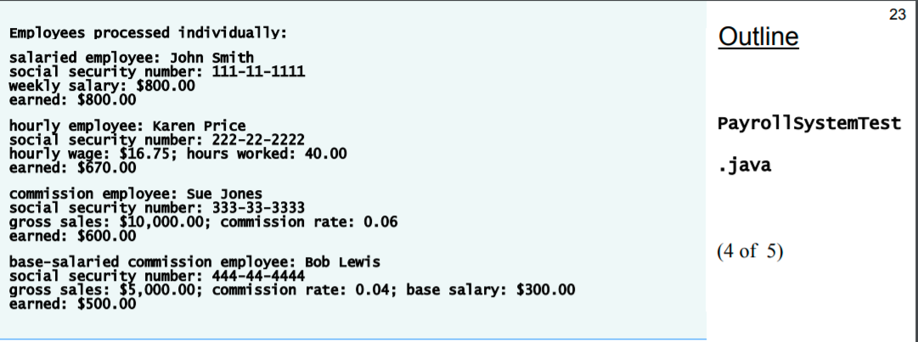

Slide 24
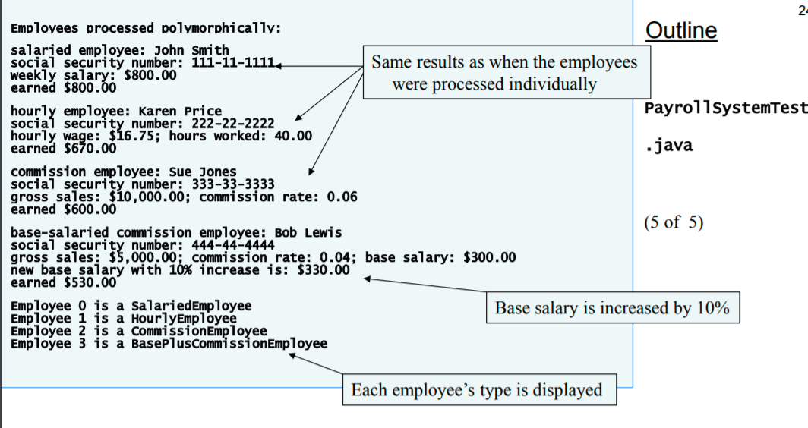

Slide 25
Useful Methods
getClass() method
Inehrited from object
Returns an object of type java.lang.class
getName() method of Class class
Returns tha class’s name

Slide 26
final Methods and Classes
Final methods
Cannot be overriden in a subclass
Private and static methods are implicitly final
Final methods are resolved at compile time
Final classes
Cannot be extended by a subclass
All methods in a final class are implicitly final

Slide 27
In the Java API, the vast majority of classes are not declared final. This enables inheritance and polymorphism—the fundamental capabilities of object-oriented programming. However, in some cases, it is important to declare classes final—typically for security reasons.

